Slide 1
Tutorial 1
Prepared by TA Jeremy Lim

Slide 2
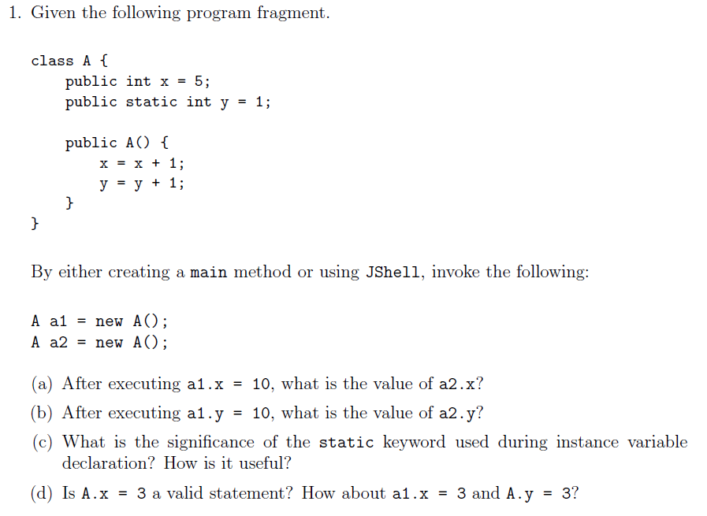
Q1

Slide 3
Q1
= 6 after initialization
6
10

Slide 4
Q1
= 6 after initialization
6
10
BAD

Slide 5
Q1
= 6 after initialization
y = 2 after initialization
y = 3 after initialization
6
10
BAD

Slide 6
Q1
Significance:
static variables are shared among all instances of the class
Changing a static variable in one instance changes it for all instances
Usefulness:
Example: Keep a running ID
Don’t have to loop through all instances to change a variable Example: Instances of a class upload data to the same server. A static server variable allows the server to be changed for all instances at once if the original server goes down

Slide 7
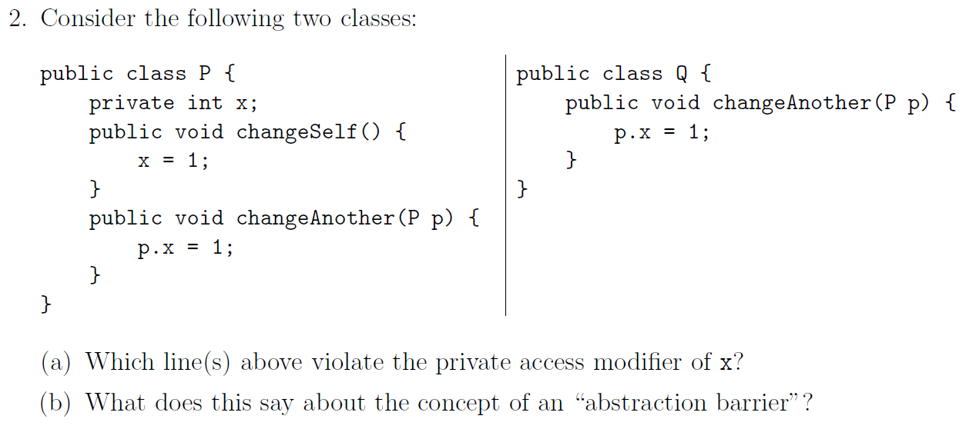
Q2

Slide 8
Q2

Slide 9
Q2
The abstraction barrier sits between the implementer (P) and the user (user of the implementer, Q)

Slide 10
Q2
Why is this okay?
The abstraction barrier sits between the implementer (P) and the user (user of the implementer, Q)

Slide 11
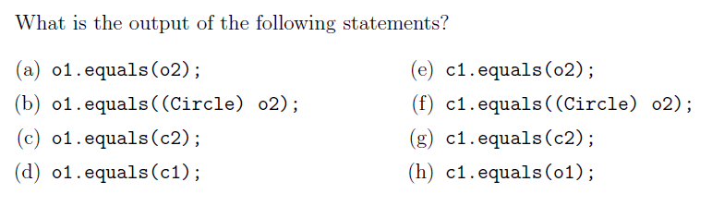
Q3
It depends.
F/F/F/T/F/F/F/T
T/T/T/T/T/T/T/T

Slide 12
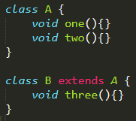

How polymorphism works
A’s Methods
one
two
A’s Impl.
one
two
B’s Methods
one
two
three
B’s Impl.
three
Notes:
Since B does not override one and two, it will use A’s implementation.

Slide 13
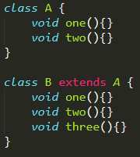
How polymorphism works
A’s Methods
one
two
A’s Impl.
one
two
B’s Methods
one
two
three
B’s Impl.
one
two
three
Notes:
Since B overrides one and two, it will use its own implementation.

Slide 14
How polymorphism works
A’s Methods
one
two
A’s Impl.
one
two
B’s Methods
one
two
three
B’s Impl.
one
two
three

Slide 15
How polymorphism works
A’s Methods
one
two
A’s Impl.
one
two
B’s Methods
one
two
three
B’s Impl.
one
two
three
Notes:
Equivalent to A a = new B();
Since a is stored as type A but initialised as type B, it has A’s methods but B’s implementation.
Note that three is inaccessible as A does not have it.

Slide 16
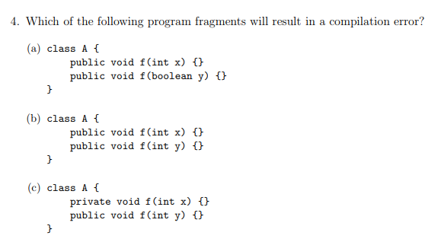
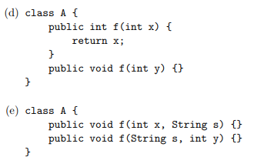
Q4

Slide 17
Q4
Error Can’t decide what to return
Error f(int) = f(int)
Error Can’t decide which to use

Slide 18
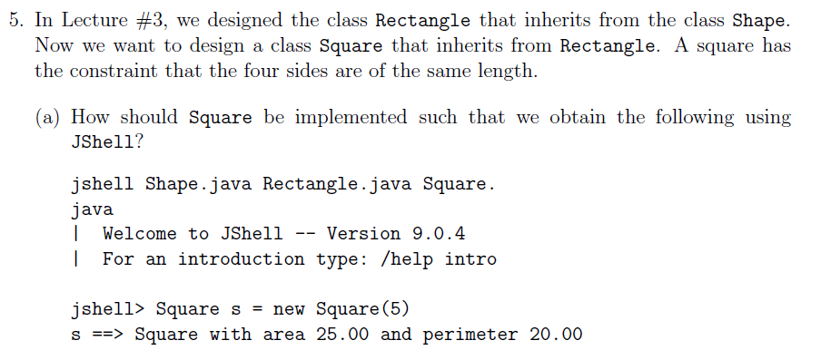
Q5

Slide 19
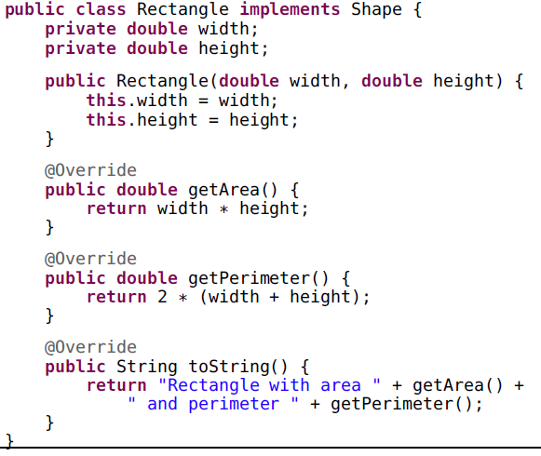
Q5

Slide 20
Q5
Square extends Rectangle
width

Slide 21
Q5
Square extends Rectangle
width
4
Notes:
More “correct” way to implement in the OO-sense

Slide 22
Q5

Slide 23
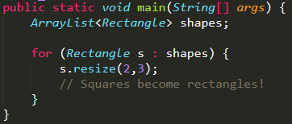
Q5
If Square extends Rectangle
Method behaviour should not change.

Slide 24
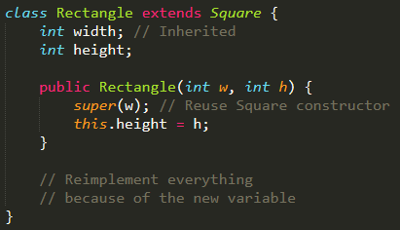
Q5
If Rectangle extends Square
Technically correct, but is almost a totally different class

Slide 25

Q5
If Rectangle extends Square
Now squares don’t have a square area!

